Slide 1







Ferhat Abbas University Setif 1
Faculty of Economic, Commercial and Management Sciences Department of Management Sciences
THE ROLE OF BLOCKCHAIN TECHNOLOGY IN ENHANCING BANKING TRANSACTIONS
A CASY STUDY of AL-SALAM BANK Setif Branch
PRESIDENT: DR. *************
SUPERVISOR: DR. *************
EXAMINER: DR. *************
Represented by: **
June 29/06/2025

Slide 2


CONTENT
1.
INTRODUCTION
3.
RESULTS & ANALYSIS
BACKGROUND
PROBLEM STATEMENT
RESEARCH OBJECTIVES
RESEARCH QUESTIONS
OPERATIONAL DEFINITIONS
OVER VIEW OF VARIABLES
PERFORMANCE COMPARISON
COST ANALYSIS
SECURITY EVALUATION
ISLAMIC FINANCE INTEGRATION
2.
METHODOLOGY
SIMULATION DESIGN
COMPARISON METRICS
4.
CONCLUSION & RECOMMENDATIONS

Slide 3


Background of the study
Blockchain is a new technology that started with Bitcoin in 2008.
While many countries are now using it, Algerian banks still use traditional systems that are slow and costly.
This research tests how Blockchain can improve banking services at Al-Salam Bank.

Slide 4

Problem Statement
Traditional Banking Limitations:
Blockchain as potential solution:
► Real-time processing
► Elimination of intermediaries
► Enhanced speed and transparency
► Improved security
► Transaction delays
► Lack of trust/transparency
► High operational costs
► Insecure data environment

Slide 5
Purpose of the study
1
2
Examine blockchain’s role in banking transactions.
Assess impact on speed, security, cost, and transparency
3
4
Evaluate customer/employee perceptions
Contribute to understand blockchain’s practical implications

Slide 6


Operational Definitions
BLOCKCHAIN
”An immutable and decentralized digital ledger that enables secure and transparent recording of transactions across a distributed network” (Tapscott & Tapscott, 2016)
Banking Transactions
”The routine financial operations executed by banks, including deposits, withdrawals, transfers, and payments” (Rose & Hudgins, 2013)

Slide 7
What is Blockchain?
Introduced in 2008 by "Satoshi Nakamoto" (Bitcoin).
Decentralized digital ledger storing secure and tamper-proof transactions.
DEFINITION
"Block" = Individual transaction record
"Chain" = Cryptographically linked sequence of blocks
Each block contains:
Transaction data
Timestamp
Hash + Previous hash

Slide 8




What is Blockchain?
KEY FEATURES OF BLOCKCHAIN
Transparency
Everyone in the network can see and verify transactions, increasing trust.

Slide 9


What is Blockchain?
KEY FEATURES OF BLOCKCHAIN
Transparency
Security
Everyone in the network can see and verify transactions, increasing trust.
Cryptographic hashes make data tamper-proof and resistant to fraud.

Slide 10

What is Blockchain?
KEY FEATURES OF BLOCKCHAIN
Transparency
Security
Decentralization
Everyone in the network can see and verify transactions, increasing trust.
Cryptographic hashes make data tamper-proof and resistant to fraud.
No central authority—control is shared across a network of users.

Slide 11


What is Blockchain?
KEY FEATURES OF BLOCKCHAIN
Transparency
Security
Decentralization
Immutability
Everyone in the network can see and verify transactions, increasing trust.
Cryptographic hashes make data tamper-proof and resistant to fraud.
No central authority—control is shared across a network of users.
Once added, transactions cannot be changed or deleted.

Slide 12


What is Blockchain?
KEY FEATURES OF BLOCKCHAIN
Transparency
Security
Decentralization
Immutability
Traceability
Everyone in the network can see and verify transactions, increasing trust.
Cryptographic hashes make data tamper-proof and resistant to fraud.
No central authority—control is shared across a network of users.
Once added, transactions cannot be changed or deleted.
Every transaction can be tracked from start to finish for auditing or verification.
Real-World Example:
Bitcoin’s public ledger allows transaction verification without revealing identities

Slide 13

What is Blockchain?
TYPES OF BLOCKCHAIN IN BANKING
Table: Blockchain Types and Banking Applications
TYPE
FEATURES BANKING
USE CASES
Public
Open, permissionless
Cryptocurrencies
Private
Restricted access
Internal bank transactions
Consortium
Multi-org govermance
Interbank settlements
Key Challenge
Integration with legacy systems and regulatory compliance

Slide 14




Traditional System Banking in algeria
Traditional banking systems are centralized systems managed by banks, where all financial transactions are processed and verified internally.
When a customer initiates an international money transfer, the request is sent to the bank, verified, and then passed through several intermediary banks using systems like SWIFT until it reaches the recipient.
This structure leads to several limitations, such as:
Slow transaction processing, especially for cross-border payments.
High costs due to multiple intermediaries.
Data silos between institutions causing duplication.
Limited real-time transparency for customers and regulators.

Slide 15
Methodology
Overview
This study compares traditional banking with a Blockchain-based model.
A simulation program was developed to reflect both centralized and decentralized systems.
The focus is on transparency, centralization, cost, and security in the Algerian banking context, specifically Al Salam Bank.

Slide 16
Methodology
Overview
Key metrics analyzed
This study compares traditional banking with a Blockchain-based model.
A simulation program was developed to reflect both centralized and decentralized systems.
The focus is on transparency, centralization, cost, and security in the Algerian banking context, specifically Al Salam Bank.
Transparency and
Centralization
Cost
Speed
Security

Slide 17
Methodology
Overview
Key metrics analyzed
Tools & Data Handling
This study compares traditional banking with a Blockchain-based model.
A simulation program was developed to reflect both centralized and decentralized systems.
The focus is on transparency, centralization, cost, and security in the Algerian banking context, specifically Al Salam Bank.
Transparency and Centralization
Cost
Speed
Security
The system was built using Python & JavaScript with Blockchain logic (SHA-256, ), tested over 1 month using 20 virtual clients and 19 transaction types.

Slide 18

SALAM BLOCK SIMULATION
Key Components
Python-based simulation environment
20 real clients with actual transaction data
19 transaction types:
► Deposits
► Withdrawals
► Transfers
► International payments
► Salam contracts
April 2025 transaction period

Slide 19

SALAM BLOCK SIMULATION
I created a Python simulation of a blockchain banking system using real-life data (April 2025). Compare how the same operations perform under blockchain vs traditional methods.

Slide 20


SALAM BLOCK SIMULATION
I created a Python simulation of a blockchain banking system using real-life data (April 2025). Compare how the same operations perform under blockchain vs traditional methods.
SIMULATES
1
2
3
Deposits, withdrawals, transfers (19 real transactions, 20 clients)
Each transaction = 1 block, hashed & linked
Basic smart contract logic for Islamic Salam contracts

Slide 21
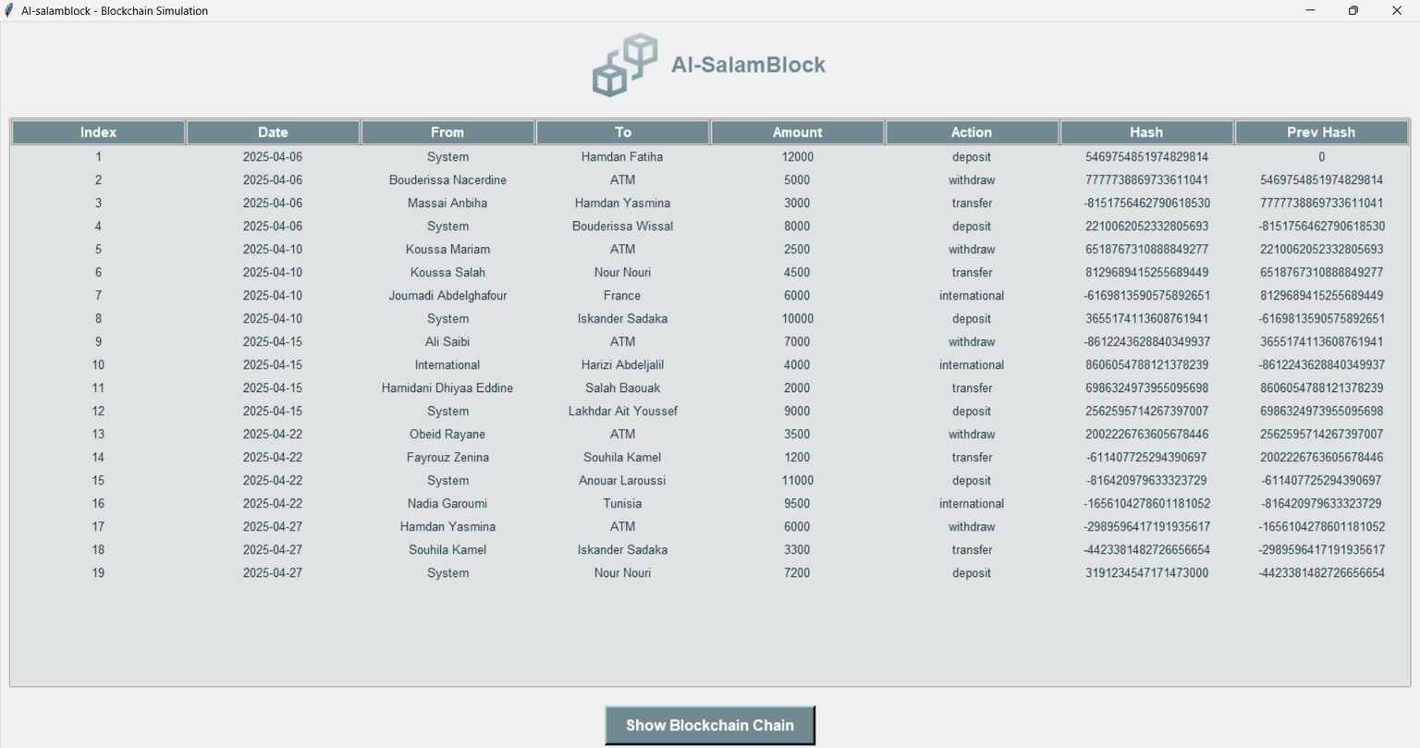
SALAM BLOCK SIMULATION
ALSALAM-BLOCK Transactions

Slide 22
Technical Implementation
Blockchain Architecture
1
2
SHA-256 hashing
PBFT consensus
3
Smart contract logic
5
4
Distributed validation
Immutable ledger

Slide 23
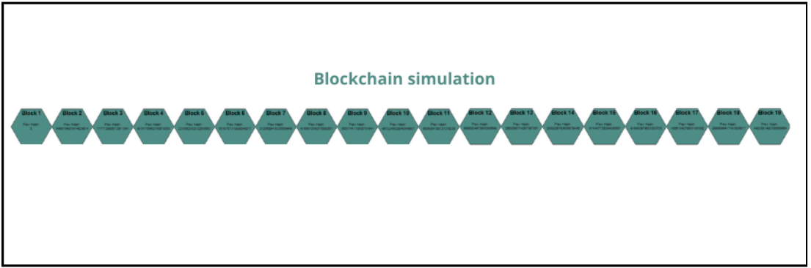
Technical Implementation
Blockchain Architecture
Figure: Blockchain structure
Innovation:
First implementation of Salam contracts in Blockchain for Islamic banking

Slide 24


TRADITIONAL SALAM BANKING VS AL-SALAM BLOCK
RESULTS
The simulation compared the traditional banking system with Al-Salam Block using real transaction data.
Key results include:
SPEED
Traditional System: International transfers took 1–3 days.
Al-Salam Block: Transfers completed in under 0.1 seconds.
Result: Over 99% faster transaction processing.

Slide 25

TRADITIONAL SALAM BANKING VS AL-SALAM BLOCK
RESULTS
The simulation compared the traditional banking system with Al-Salam Block using real transaction data.
Key results include:
SPEED
COST REDUCTION
Traditional System: International transfers took 1–3 days.
Al-Salam Block: Transfers completed in under 0.1 seconds.
Result: Over 99% faster transaction processing.
Traditional operations involved high fees (up to 2000 DZD).
Blockchain system removed intermediaries and manual steps.
Result: Up to 50% cost savings in simulated transactions.

Slide 26

TRADITIONAL SALAM BANKING VS AL-SALAM BLOCK
RESULTS
The simulation compared the traditional banking system with Al-Salam Block using real transaction data.
Key results include:
SPEED
COST REDUCTION
ENHANCED SECURITY
Traditional System: International transfers took 1–3 days.
Al-Salam Block: Transfers completed in under 0.1 seconds.
Result: Over 99% faster transaction processing.
Traditional operations involved high fees (up to 2000 DZD).
Blockchain system removed intermediaries and manual steps.
Result: Up to 50% cost savings in simulated transactions.
Al-Salam Block used SHA-256 hashing and chain linking.
Any tampering would break the chain, exposing manipulation.
Result: Strong fraud protection and data integrity.

Slide 27

TRADITIONAL SALAM BANKING VS AL-SALAM BLOCK
RESULTS
The simulation compared the traditional banking system with Al-Salam Block using real transaction data.
Key results include:
SPEED
COST REDUCTION
ENHANCED SECURITY
TRANSPARENCY & TRUST
Traditional System: International transfers took 1–3 days.
Al-Salam Block: Transfers completed in under 0.1 seconds.
Result: Over 99% faster transaction processing.
Traditional operations involved high fees (up to 2000 DZD).
Blockchain system removed intermediaries and manual steps.
Result: Up to 50% cost savings in simulated transactions.
Al-Salam Block used SHA-256 hashing and chain linking.
Any tampering would break the chain, exposing manipulation.
Result: Strong fraud protection and data integrity.
All transactions are visible and traceable in the blockchain.
The system ensures real-time access and auditability.
Result: Improved user trust and regulatory readiness.

Slide 28

TRADITIONAL SALAM BANKING VS AL-SALAM BLOCK
RESULTS
The simulation compared the traditional banking system with Al-Salam Block using real transaction data.
Key results include:
SPEED
COST REDUCTION
ENHANCED SECURITY
TRANSPARENCY & TRUST
ISLAMIC FINANCE COMPLIANCE
Traditional System: International transfers took 1–3 days.
Al-Salam Block: Transfers completed in under 0.1 seconds.
Result: Over 99% faster transaction processing.
Traditional operations involved high fees (up to 2000 DZD).
Blockchain system removed intermediaries and manual steps.
Result: Up to 50% cost savings in simulated transactions.
Al-Salam Block used SHA-256 hashing and chain linking.
Any tampering would break the chain, exposing manipulation.
Result: Strong fraud protection and data integrity.
All transactions are visible and traceable in the blockchain.
The system ensures real-time access and auditability.
Result: Improved user trust and regulatory readiness.
Salam contracts were implemented as smart contracts.
Automatically ensured advance payment and delivery terms.
Result: Fully aligned with Sharia principles.

Slide 29
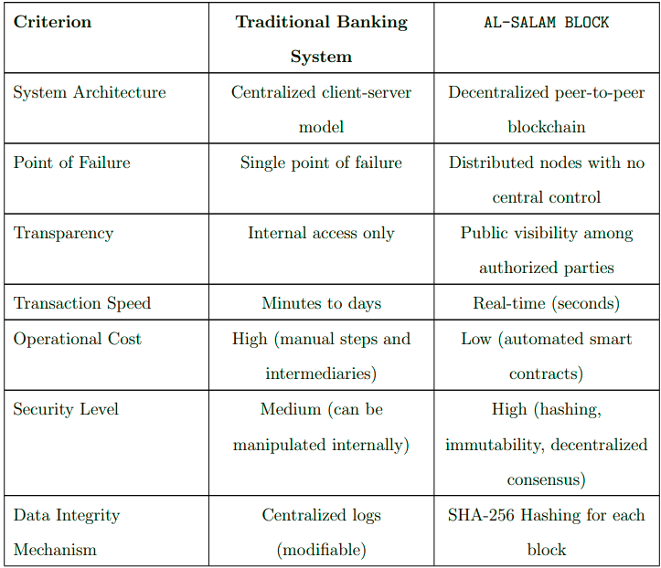
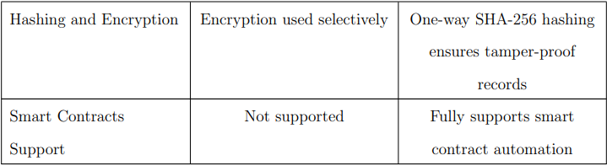
Traditional SALAM banking vs AL-SALAM Block
The table clearly shows that Al-Salam Block outperforms the traditional system in speed, cost, security, and transparency while also supporting Islamic contracts through smart automation.

Slide 30
Conclusion
The "Al-Salam Blockchain" simulation demonstrated that Blockchain technology offers a high level of transparency by recording all transactions in a shared digital ledger that can be tracked and verified by all parties. Transaction speed improved through instant automation without the need for intermediaries, significantly reducing processing time. In terms of security, the system provided strong protection against tampering and cyberattacks through advanced encryption and linked block chains. Regarding cost, the reduction of intermediaries and automated processes helped lower operational expenses, making Blockchain an economical and efficient option for banks seeking modern digital solutions.

Slide 31





Recommendations
Phased Implementation: Start with inter-branch transfers and customer onboarding.
Legal Frameworks: Recognize smart contracts and digital signatures.
Security Protocols: Adopt multi-factor authentication and ISO/IEC 27001 standards.
Training Programs: Educate bankers, IT staff, and regulators on blockchain.
Technology Integration: Use cloud solutions and efficient consensus mechanisms like PBFT.

Slide 32



Thank you very much!
Questions or Feedback?
Supervisor: Dr. Hadjer Yahia Examiner:Dr. Rima Chiboub

